Slide 1
Flipkart CSAT Analysis
Flipkart is one of India’s leading e-commerce platforms, offering a wide range of products, including electronics, fashion, home goods and more. As a major player in the online retail space, Flipkart strives to provide exceptional customer service to maintain its competitive edge and ensure customer satisfaction.

Slide 2
Business problem, objective and goal
Goal
The goal of this project is to analyze Flipkart’s customer service data to identify insights and areas of improvement that can enhance customer retention.
Business Problem
Flipkart has recently seen a drop in customer retention. To tackle this, the company is analyzing its customer service operations to identify issues affecting customer experience, as strong service is key to retaining customers and building loyalty.
Project Structure
Understanding the Business Context and Define Metrics
Exploratory Data Analysis (EDA)
Build Dashboard
Objective
The objective of this project is to analyze customer call data to evaluate service performance and identify issues impacting customer satisfaction and retention.

Slide 3
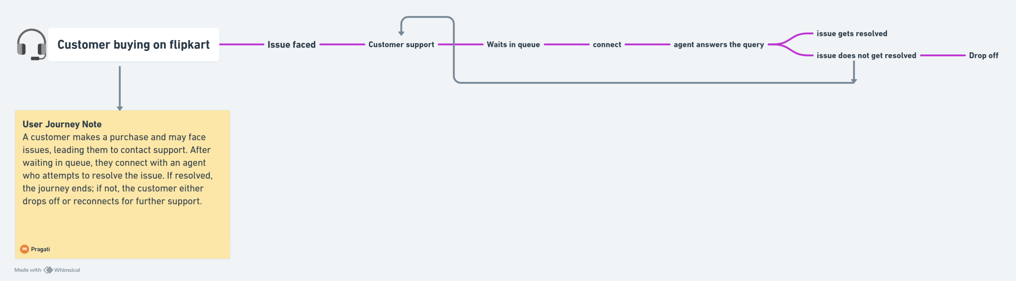
User journey on flipkart
https://whimsical.com/pragati-s-workspace587/customer-buying-on-flipkart-UEqBLpWTznPHC7QiP8EGh3

Slide 4
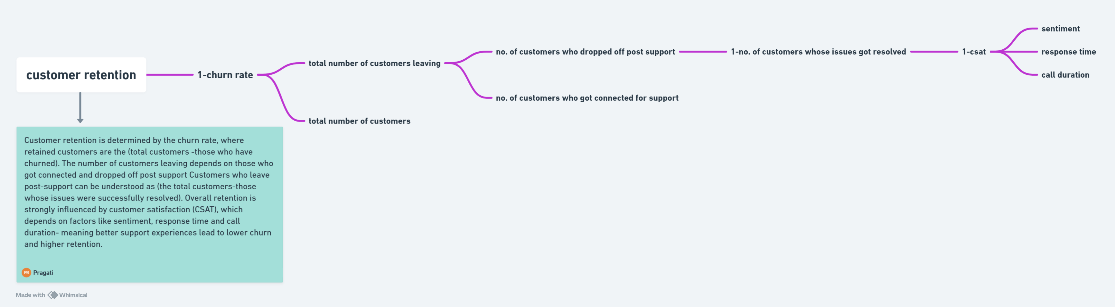
Customer Retention
https://whimsical.com/pragati-s-workspace587/customer-retention-M94tJvphtsbKgFKfKmLGne

Slide 5
CSAT (Key Metric)
Response Time
Call Duration
Sentiment
Within SLA
Below SLA
Above SLA
Short
Medium
Long/Very Long
1.Very Positive
2.Positive
3.Neutral
4.Negative
5.Very Negative

Slide 6
Hypothesis
A hypothesis is a testable assumption about what might be causing a problem.
Call duration
Call duration is short, high CSAT score, vice-versa.
Call centers
Some call centers have higher CSAT scores compared to others.
Response time
Less response time, high CSAT score, vice-versa.
Sentiments
Negative sentiments results in less CSAT scores whereas positive sentiment results in higher CSAT score.
Channel
Some channels have higher CSAT scores compared to others. eg., call center, chatbots, email, web

Slide 7
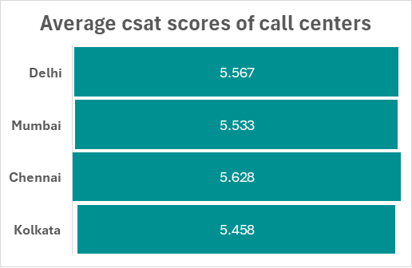
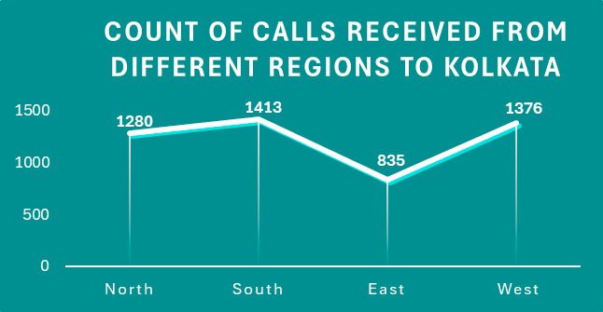
Root-Cause-Analysis (RCA)
After selecting CSAT as the key metric and calculating the average CSAT score across call centers, it was observed that Kolkata has the lowest CSAT. To investigate further, a hypothesis was performed that the issue could be due to the nature of calls handled by the Kolkata center. To test this, the distribution of calls by region was analyzed. It was found that Kolkata handles a higher number of calls from South and West regions and least from East. This could be impacting service efficiency and in turn, lowering CSAT.

Slide 8
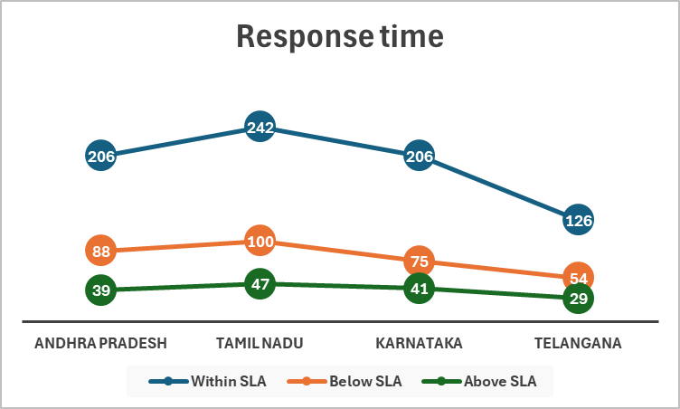
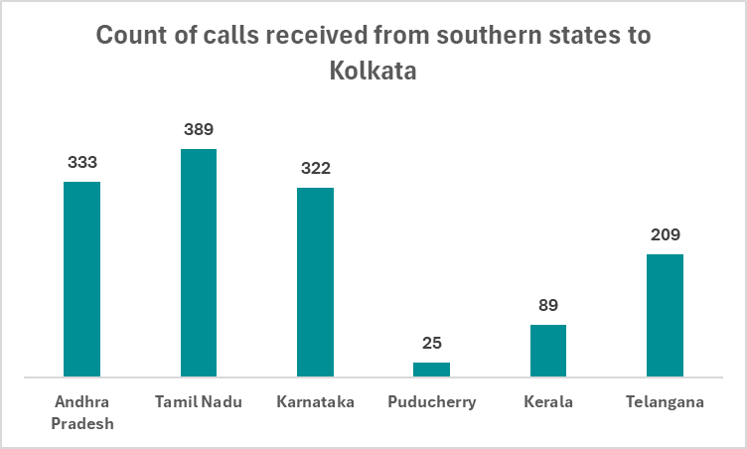
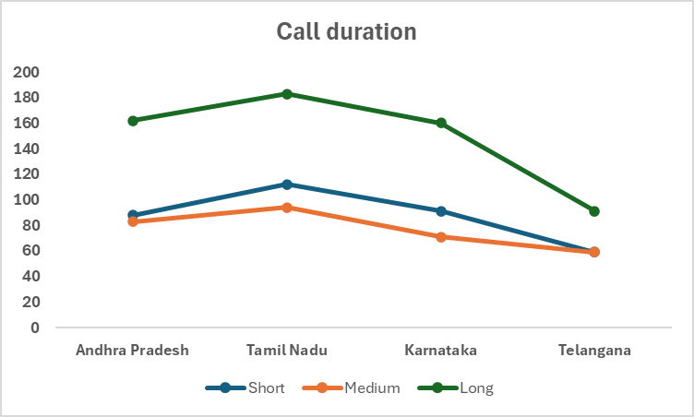
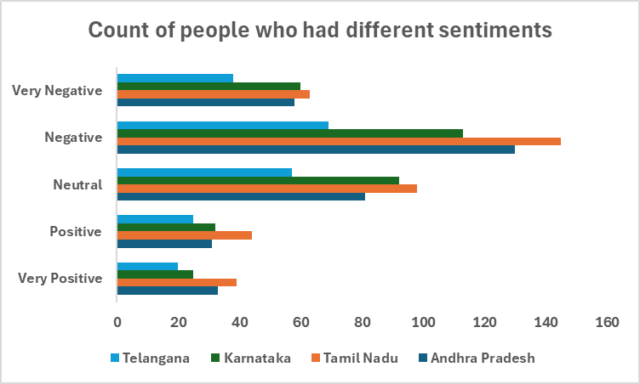

Slide 9
After identifying that the Kolkata call center receives a high volume of calls from the South region, a deeper analysis was conducted to understand the underlying factors. It was observed that Andhra Pradesh, Tamil Nadu, Karnataka and Telangana contribute the highest number of calls to the Kolkata center.
Further analysis was done on key service parameters such as sentiment, call duration and response time. The response time was not found to be a major issue, as most calls were handled within or below SLA, indicating timely responses.
However, a closer look at customer sentiment revealed a higher proportion of negative and very negative sentiments, suggesting dissatisfaction. Additionally, the call duration was significantly longer, indicating that issues may be complex or not being resolved efficiently.
These factors- higher negative sentiment and longer call durations- are likely contributing to the lower CSAT scores for the Kolkata call center.
After identifying that the Kolkata call center has a lower CSAT score, it was observed that it receives a higher volume of calls from southern regions. This may be due to factors such as language barriers and inadequate agent training, leading to more negative customer sentiments. Additionally, longer call durations were observed, which may indicate inefficiencies in issue resolution.
However, is the call center solely responsible for the lower CSAT score, or are there other contributing factors, such as different service channels? Let’s explore this further.

Slide 10
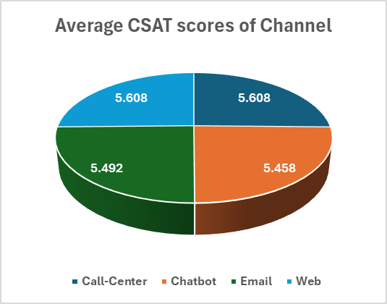
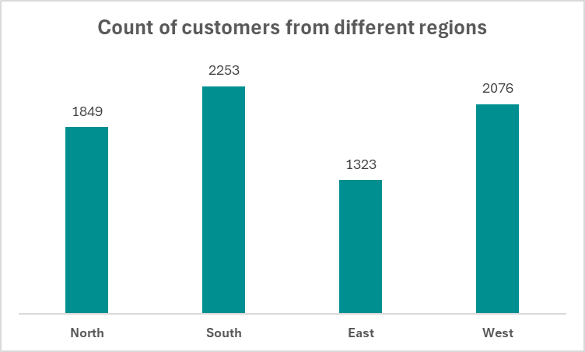
Channel Hypothesis
Chatbot has received less CSAT score
compared to other channels
The chatbot is receiving a higher volume of queries from customers in the South region compared to other regions.

Slide 11
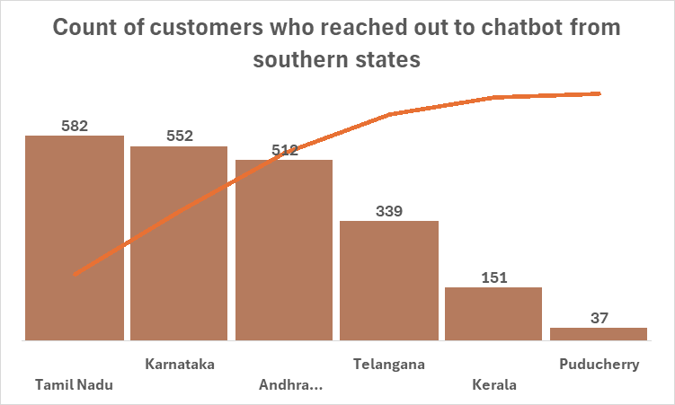
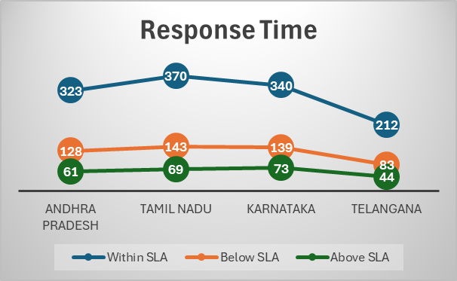
After identifying that the South region generates the highest number of customers, a further breakdown shows that Tamil Nadu, Andhra Pradesh, Telangana and Karnataka contribute the majority of these queries.
Response time does not appear to be a major issue, as most of the calls are handled within or below the SLA.

Slide 12
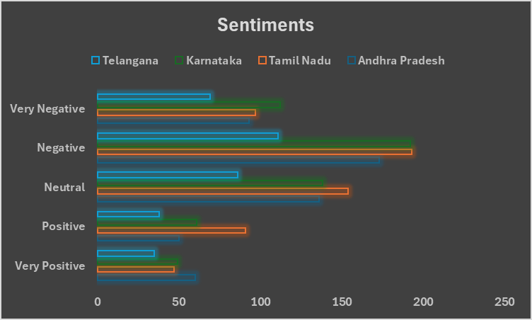
A significant proportion of customer interactions show negative and very negative sentiments, indicating dissatisfaction with the service experience.
Customers from the southern region appear to be less satisfied with the chatbot experience. This is evident from the higher volume of queries originating from states like Tamil Nadu, Andhra Pradesh, Telangana, and Karnataka, combined with a noticeable increase in negative sentiment. Despite response times largely being within or below SLA, the dissatisfaction suggests that the chatbot may not be effectively resolving customer issues, leading to frustration and repeat interactions.

Slide 13
Multilingual Support:
Provide support in regional languages (Tamil, Telugu, Kannada) and route queries to region-specific agents to reduce language barriers and improve customer experience.
Improve Chatbot: Train the chatbot on region-specific queries and enable quick transfer to a human agent when needed to avoid customer frustration.
Reduce Call Duration:
Focus on faster and effective issue resolution through better scripts, tools, and emphasis on first call resolution (FCR).
Agent Training:
Train agents on communication, empathy, and handling difficult customers to improve overall interaction quality.
Fix Common Issues:
Identify frequent problems like billing or payments and create standardized solutions to reduce repeat calls.
Smart Call Routing:
Route calls based on language, region, and issue type to ensure the right agent handles the query.
Monitor Sentiment:
Track negative sentiment and take immediate action (like escalation or feedback loops) to improve service quality.
Key Solutions to reduce negative sentiments and increase csat scores for both call center and chatbot
PRAGATI BAID

